Slide 1
Objectives
In this session, you will learn to:
  Create invoice
Notes:
Share the session objectives with the students.

Slide 2
Creating Invoice
Tally.ERP 9:
  Has an in-built system to create and print sales invoices.
  Helps you in recording sales and purchase invoice details and in adjusting accounting and inventory balances.

Slide 3

Creating Invoice (Contd.)
Let us see how to enable the option of invoicing.
Notes:
You need to perform the steps given under the following topic:
5.3 Invoicing (page 122)

Slide 4
Creating Invoice (Contd.)
The following table shows a sales voucher.
Field | Details
Ref:
Dr | Supreme Computers
Debit Amount | 3,200
Cr | Component Sales
Name of item | USB Pen Drives 64 MB
Godown | On-site
Quantity | 2 Nos
Rate | 1,600 (accept)
Per | Nos (accept)
Amount | 3,200.00
Narration | __
Accept? Yes or No | Yes

Slide 5
Creating Invoice (Contd.)
Let us see how to enter the preceding data of sales in voucher mode.
Notes:
You need to perform the steps given under the following topic:
5.3 Invoicing (page 122)

Slide 6
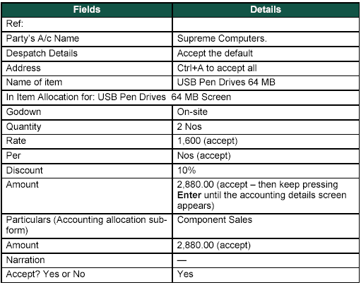
Creating Invoice (Contd.)
The following figure shows a sales voucher.

Slide 7
Creating Invoice (Contd.)
Let us see how to enter the preceding data of sales in invoice mode.
Notes:
You need to perform the steps given under the following topic:
5.3 Invoicing (page 123)

Slide 8
Creating Invoice (Contd.)
Item Invoice and Account Invoice:
  Account invoice option allows you to select the ledgers instead of the stock items.
  Item invoice option allows you to select stock items instead of ledgers.

Slide 9
Creating Invoice (Contd.)
Let us see how to create an item invoice.
Notes:
You need to perform the steps given under the following topic:
5.3.2 Walk-through to create an Item Invoice (page 124)

Slide 10
Creating Invoice (Contd.)
Let us see how to create an account invoice.
Notes:
You need to perform the steps given under the following topic:
5.3.3 Walk-through to create an Account Invoice (page 124)

Slide 11
Summary
In this session, you learned that:
  Tally.ERP 9 allows to create and print sales invoices.

